Slide 1


Slide 2
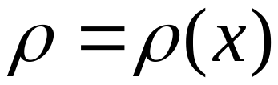
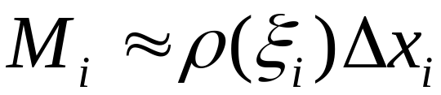
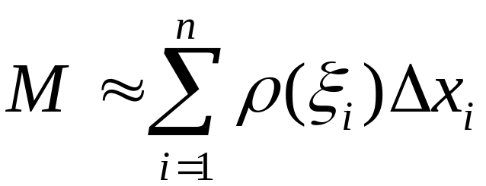
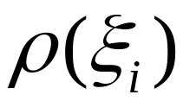




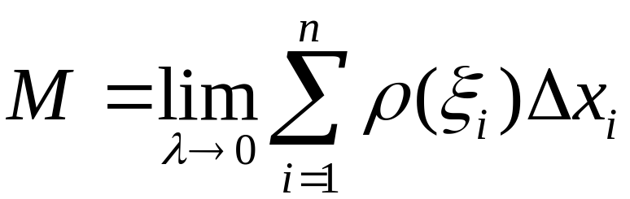
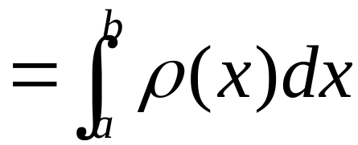
Recall . Mass of a rod
density：

Slide 3
If a curved rod?
Find mass?

Slide 4

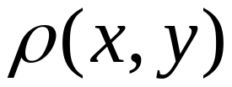



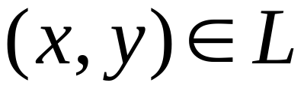
Ideas are the same
If：
At each point
The density is
Find mass

Slide 5



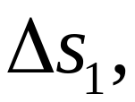
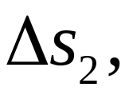
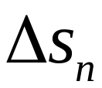
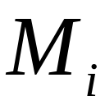
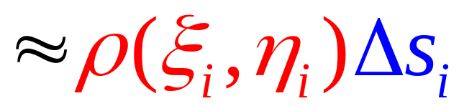
Standard process
(1) partition
(2) approximation

Slide 6
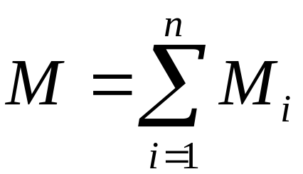
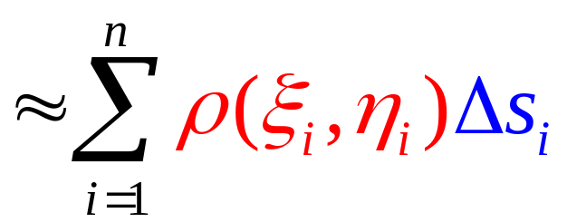
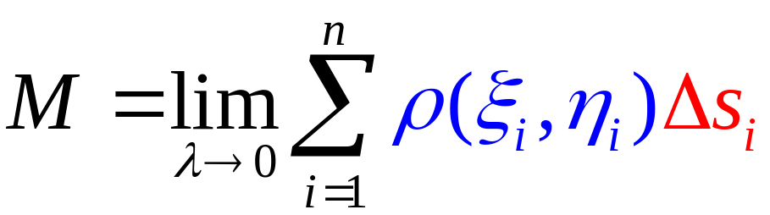

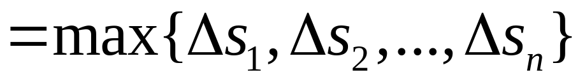
(3) Summation
(4) Take the limit

Slide 7
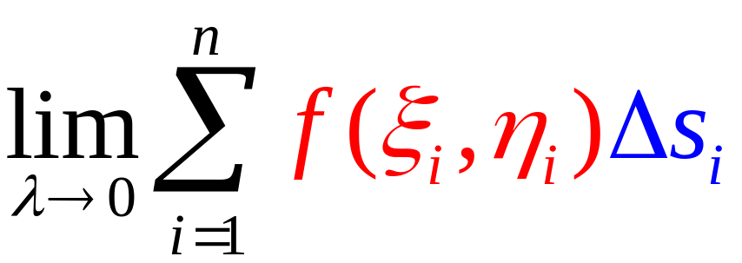
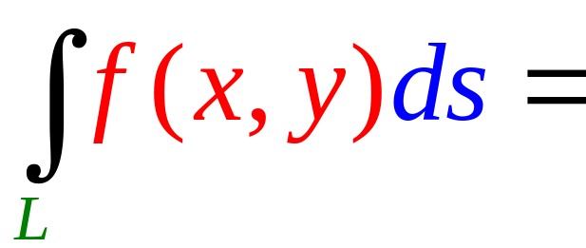

Line integral with respect to arc length
Curve of integration
integrand
Arc length element

Slide 8
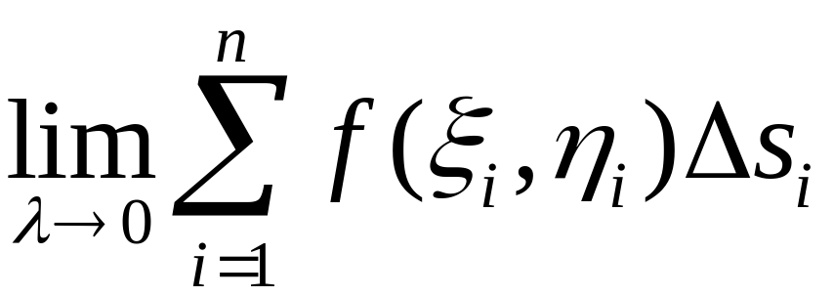


Line integrals with respect to arc length

Slide 9
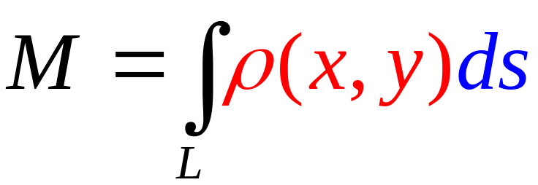
Mass of a curved rod
Mass

Slide 10
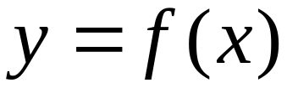
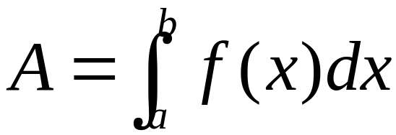
Geometric interpretation
Recall:
The geometric interpretation of definite integral , then line integral ?

Slide 11
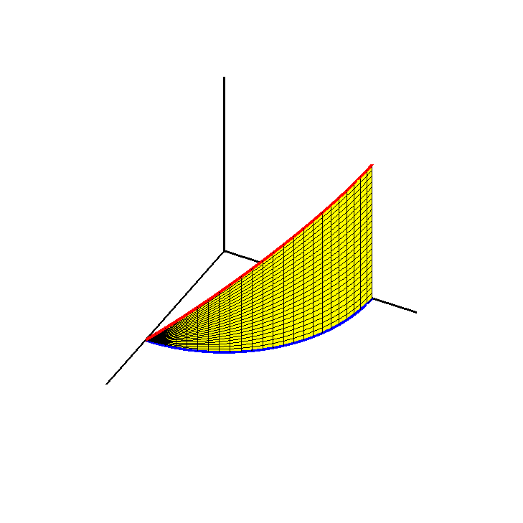
with(plots):R:=1:
x_axis:=plot3d([u,0,0],u=0..1.5,v=0..0.01,thickness=3):
y_axis:=plot3d([0,u,0],u=0..1.3,v=0..0.01,thickness=3):
z_axis:=plot3d([0,0,u],u=0..1.3,v=0..0.01,thickness=3):
zuobiaoxi:=display(x_axis,y_axis,z_axis):
zhumian1:=plot3d([R*cos(t),R*sin(t),z],z=0..R*sin(t),t=0..Pi/2,color=yellow):
quxian1:=spacecurve([R*cos(t),R*sin(t),R*sin(t)],t=0..2*Pi,color=red,thickness=3):
zhumian2:=plot3d([R*cos(t),y,R*sin(t)],y=0..R*sin(t),t=0..Pi/2,color=green):
quxian2:=spacecurve([R*cos(t),-R*sin(t),R*sin(t)],t=0..2*Pi,color=blue,thickness=3):
display(zhumian2,zhumian1,zuobiaoxi,scaling=constrained,orientation=[28,53]);

Slide 12
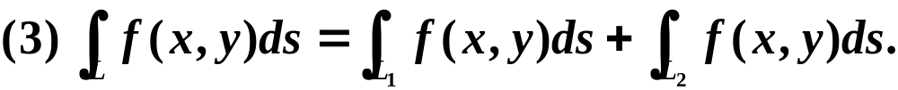



Properties

Slide 13


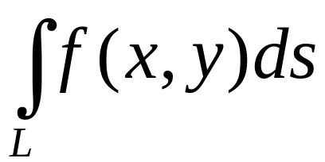

(4)
= L the length of the arc
(5)
Integration over an enclosed curve L.

Slide 14
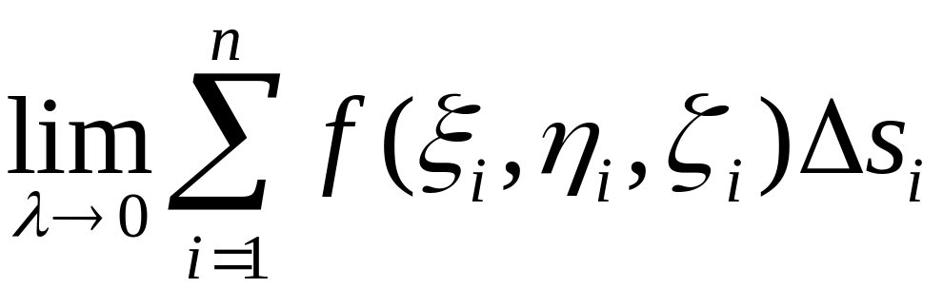
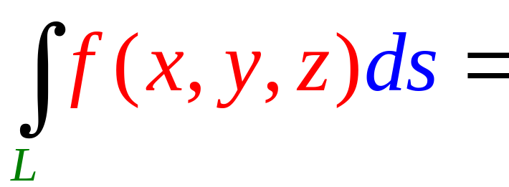


Line integral with respect to arc length in the space

